Slide 1
Lecture 10
Signals and Systems (ELL205)
By Dr. Abhishek Dixit
Dept. of Electrical Engineering
IIT Delhi

Slide 2
Outline of the lecture
Use h(t) to determine whether the system is:
  Memoryless
  Causal
  Stable
  Invertible
Applications of h(t) to real-life scenarios
System designing

Slide 3

System properties
Memoryless system:
$$h\left(t\right)=kδ(t)$$

Slide 4


System properties
Memoryless system:
$$h\left(t\right)=kδ(t)$$
Causal system:
$$h\left(t\right)=0$$
$$t<0$$

Slide 5
System properties
Memoryless system:
$$h\left(t\right)=kδ(t)$$
Causal system:
$$h\left(t\right)=0$$
$$t<0$$
Causal and linear system:
Condition of initial rest

Slide 6

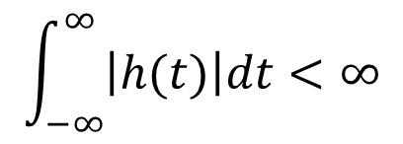
System properties
Memoryless system:
$$h\left(t\right)=kδ(t)$$
Causal system:
$$h\left(t\right)=0$$
$$t<0$$
Causal and linear system:
Condition of initial rest
$$\int_{−∞}^{∞}{\left|h(t)\right|dt<∞}$$
Stability:

Slide 7
Outline of the lecture
Use h(t) to determine whether the system is:
  Memoryless
  Causal
  Stable
  Invertible
Applications of h(t) to real-life scenarios
System designing

Slide 8


Invertible
A system is said to be invertible if distinct inputs lead to distinct outputs.
S
S⁻¹
$$x(t)$$
$$x\left(t\right)$$
Invertible Inverse
$x\left(t\right)∗h\left(t\right)∗h_{inv}\left(t\right)=x(t)$

Slide 9

System properties
S
S⁻¹
$$y(t)$$
$$x(t)$$
$$x\left(t\right)$$
Invertible Inverse
$x\left(t\right)∗h\left(t\right)∗h_{inv}\left(t\right)=x(t)$

Slide 10



System properties
S
S⁻¹
$$y(t−τ)$$
$$x(t−τ)$$
$$x\left(t−τ\right)$$
Invertible Inverse
$x\left(t\right)∗h\left(t\right)∗h_{inv}\left(t\right)=x(t)$

Slide 11


System properties
S
S⁻¹
$$y(t)$$
$$x(t)$$
$$x\left(t\right)$$
Invertible Inverse
$x\left(t\right)∗h\left(t\right)∗h_{inv}\left(t\right)=x(t)$

Slide 12


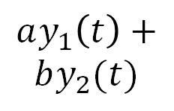
System properties
S
S⁻¹
$${ax}_{1}\left(t\right)+bx_{2}(t)$$
$$ay_{1}\left(t\right)+$$
$$by_{2}(t)$$
$$ax_{1}\left(t\right)+bx_{2}(t)$$
Invertible Inverse
$x\left(t\right)∗h\left(t\right)∗h_{inv}\left(t\right)=x(t)$

Slide 13


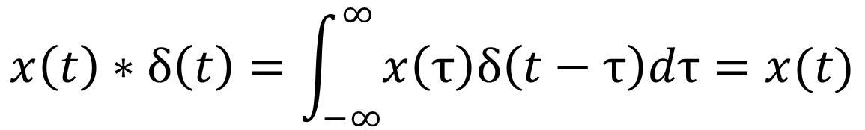
Invertible
A system is said to be invertible if distinct inputs lead to distinct outputs.
$x\left(t\right)∗h\left(t\right)∗h_{inv}\left(t\right)=x(t)$
$$h\left(t\right)∗h_{inv}\left(t\right)=?$$
$$x\left(t\right)∗δ\left(t\right)=\int_{−∞}^{∞}{x\left(τ\right)δ\left(t−τ\right)dτ}=x(t)$$

Slide 14


Design example
$$y\left[n\right]=x\left[n\right]$$
T
Rx

Slide 15

Design example
$$y\left[n\right]=x\left[n\right]$$
$$+ax[n−1]$$
Multi-path fading
Tx
Rx

Slide 16
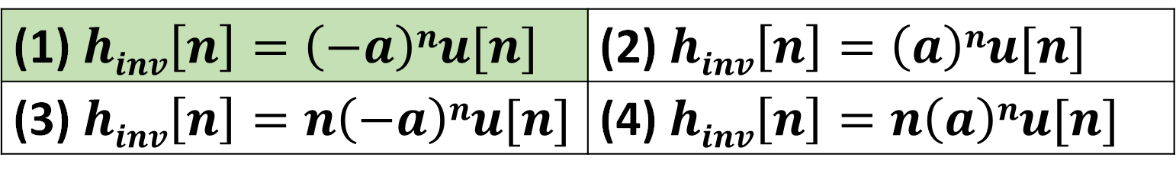

Design example
A causal system to inverse is:
$$y\left[n\right]=x\left[n\right]+ax\left[n−1\right]$$
(1) $hinv\left[n\right]=\left(−a\right)nu[n]$ | (2) $hinv\left[n\right]=\left(a\right)nu[n]$
(3) $hinv\left[n\right]=n\left(−a\right)nu[n]$ | (4) $hinv\left[n\right]=n\left(a\right)nu[n]$

Slide 17
Examples of systems where h(t) is a natural metric of system description
Communication System
Optical System

Slide 18
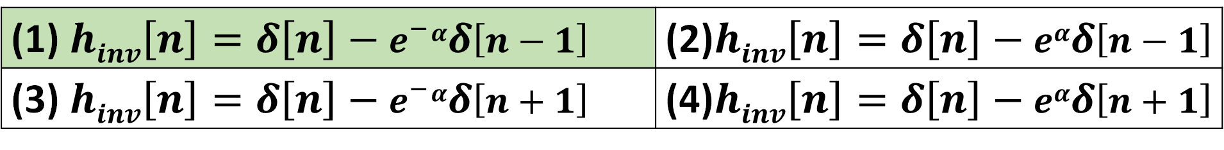
Design example
A causal system to inverse
is:
$y\left[n\right]=x\left[n\right]+e^{−}αx\left[n−1\right]$+$e^{−}2αx\left[n−2\right]$+……..
(1) $hinv\left[n\right]=δ\left[n\right]−e^{−}αδ\left[n−1\right]$ | (2)$hinv\left[n\right]=δ\left[n\right]−eαδ\left[n−1\right]$
(3) $hinv\left[n\right]=δ\left[n\right]−e^{−}αδ\left[n+1\right]$ | (4)$hinv\left[n\right]=δ\left[n\right]−eαδ\left[n+1\right]$

Slide 19
Examples of systems where h(t) is a natural metric of system description
A twisted pair coax has an impulse response as shown:
The maximum bit rate is
h(t)
1 ms
1) 100 Kb/s | 2) 1 Mb/s
3) 10 Kb/s | 4) 1 Kb/s

Slide 20
Examples of systems where h(t) is a natural metric of system description
A twisted pair coax has an impulse response as shown:
The maximum bit rate is
h(t)
1 ms
1) 100 Kb/s | 2) 1 Mb/s
3) 10 Kb/s | 4) 1 Kb/s

Slide 21

Examples of systems where h(t) is a natural metric of system description
The maximum bit rate is:
how fast the transmitter can spit out the bits 1100001100000 ?
1 1 0 0 0 1
$$∗$$
h(t)
1 ms

Slide 22

Examples of systems where h(t) is a natural metric of system description
The maximum bit rate is:
how fast the transmitter can spit out the bits 1100001100000 ?
1 1 0 0 0 1
$$∗$$
h(t)
$$=$$
1 ms
1 ms
1 ms

Slide 23
Examples of systems where h(t) is a natural metric of system description
Communication System
Optical System

Slide 24

Optical system

Slide 25

Optical system
Point spread function

Slide 26
Outline of the lecture
System designing

Slide 27
Basic DT system
Basic characteristics:
Linear (if delay starts at rest)
Time-Invariant
Causal
Recipe system
FIR system
Delay

Slide 28
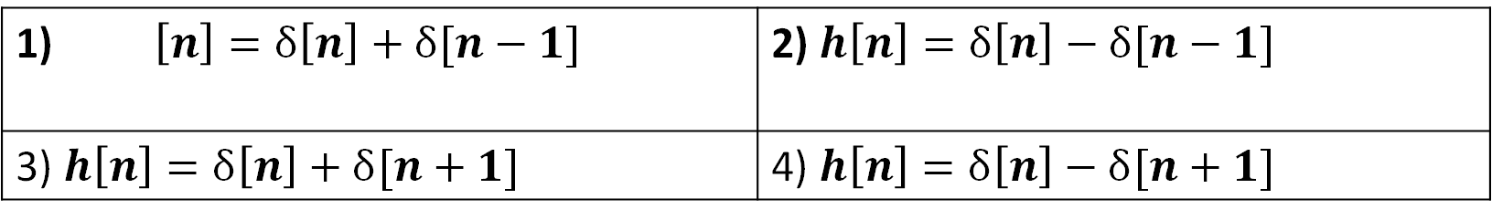
Find the impulse response
Delay
1) $\left[n\right]=δ\left[n\right]+δ[n−1]$ | 2) $h\left[n\right]=δ\left[n\right]−δ[n−1]$
3) $h\left[n\right]=δ\left[n\right]+δ[n+1]$ | 4) $h\left[n\right]=δ\left[n\right]−δ[n+1]$

Slide 29
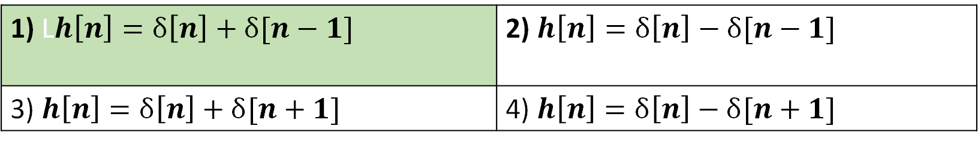
Find the impulse response
Delay
1) L$h\left[n\right]=δ\left[n\right]+δ[n−1]$ | 2) $h\left[n\right]=δ\left[n\right]−δ[n−1]$
3) $h\left[n\right]=δ\left[n\right]+δ[n+1]$ | 4) $h\left[n\right]=δ\left[n\right]−δ[n+1]$

Slide 30
Basic DT system
Basic characteristics:
Linear
Time-Invariant
Causal
Constraint/feedback system
IIR system
p_{o}
Delay

Slide 31

Basic DT system
$$h\left[n\right]=?$$
p_{o}
Delay

Slide 32
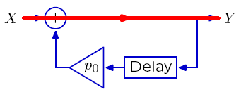
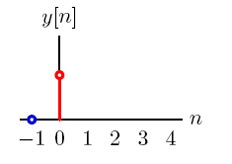
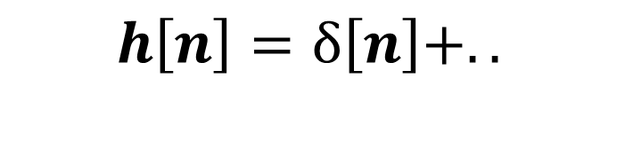
Basic DT system (Graphical method)
$$h\left[n\right]=δ\left[n\right]+..$$

Slide 33
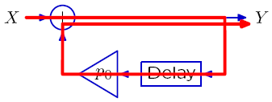
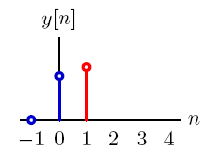
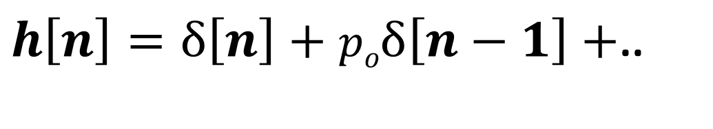
Basic DT system (Graphical method)
$h\left[n\right]=δ\left[n\right]+poδ\left[n−1\right]+$..

Slide 34
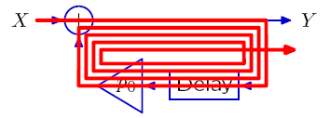
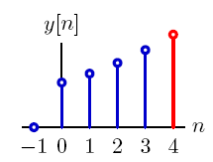
Basic DT system (Graphical method)
$$h\left[n\right]={\left(po\right)}^{n}u\left[n\right]$$

